Slide 1
People with Learning Disabilities
Produced by
Josce Syrett, Kent Public Health Observatory
With input from:
Miriam Fittipaldi, Medway Public Health Intelligence
Version: 1
Last updated: 12/06/2024

Slide 2
Key Points
Learning disability prevalence has been higher in Kent than in England since 2020/2021.
Unemployment rates for people with a learning disability in Kent are double that of the South East region.
Educational outcomes for people with a learning disability are considerably lower than the general population but Kent and Medway has similar outcomes to England and the South East.
The percentage of people with a learning disability having a health check in Kent is lower than the England average.
People with a learning disability who are white are more likely to take up the offer of a Flu vaccine compared to other ethnicities.
Nearly 1 in 5 people with a learning disability have depression in Kent and Medway.
Nearly 1 in 4 people with a learning disability are obese in Kent and Medway.

Slide 3
What is a Learning Disability?
A learning disability is a reduced intellectual ability and difficulty with everyday activities. This can affect the way a person learns things throughout their life and can affect ability to understand complex information, learning new skills and looking after themselves or living alone (NHS UK).
A learning disability manifests itself differently for everyone, no one person is the same (NHS UK).
In recent years, recorded learning disability prevalence has increased in Kent and Medway quicker than in England and the South East region and it is now above the national average in 2022/2023 (NHS Digital).
The prevalence of a learning disability is defined as the total number of patients with learning disabilities, as recorded on the practice disease register for all ages compared to the total population.

Slide 4
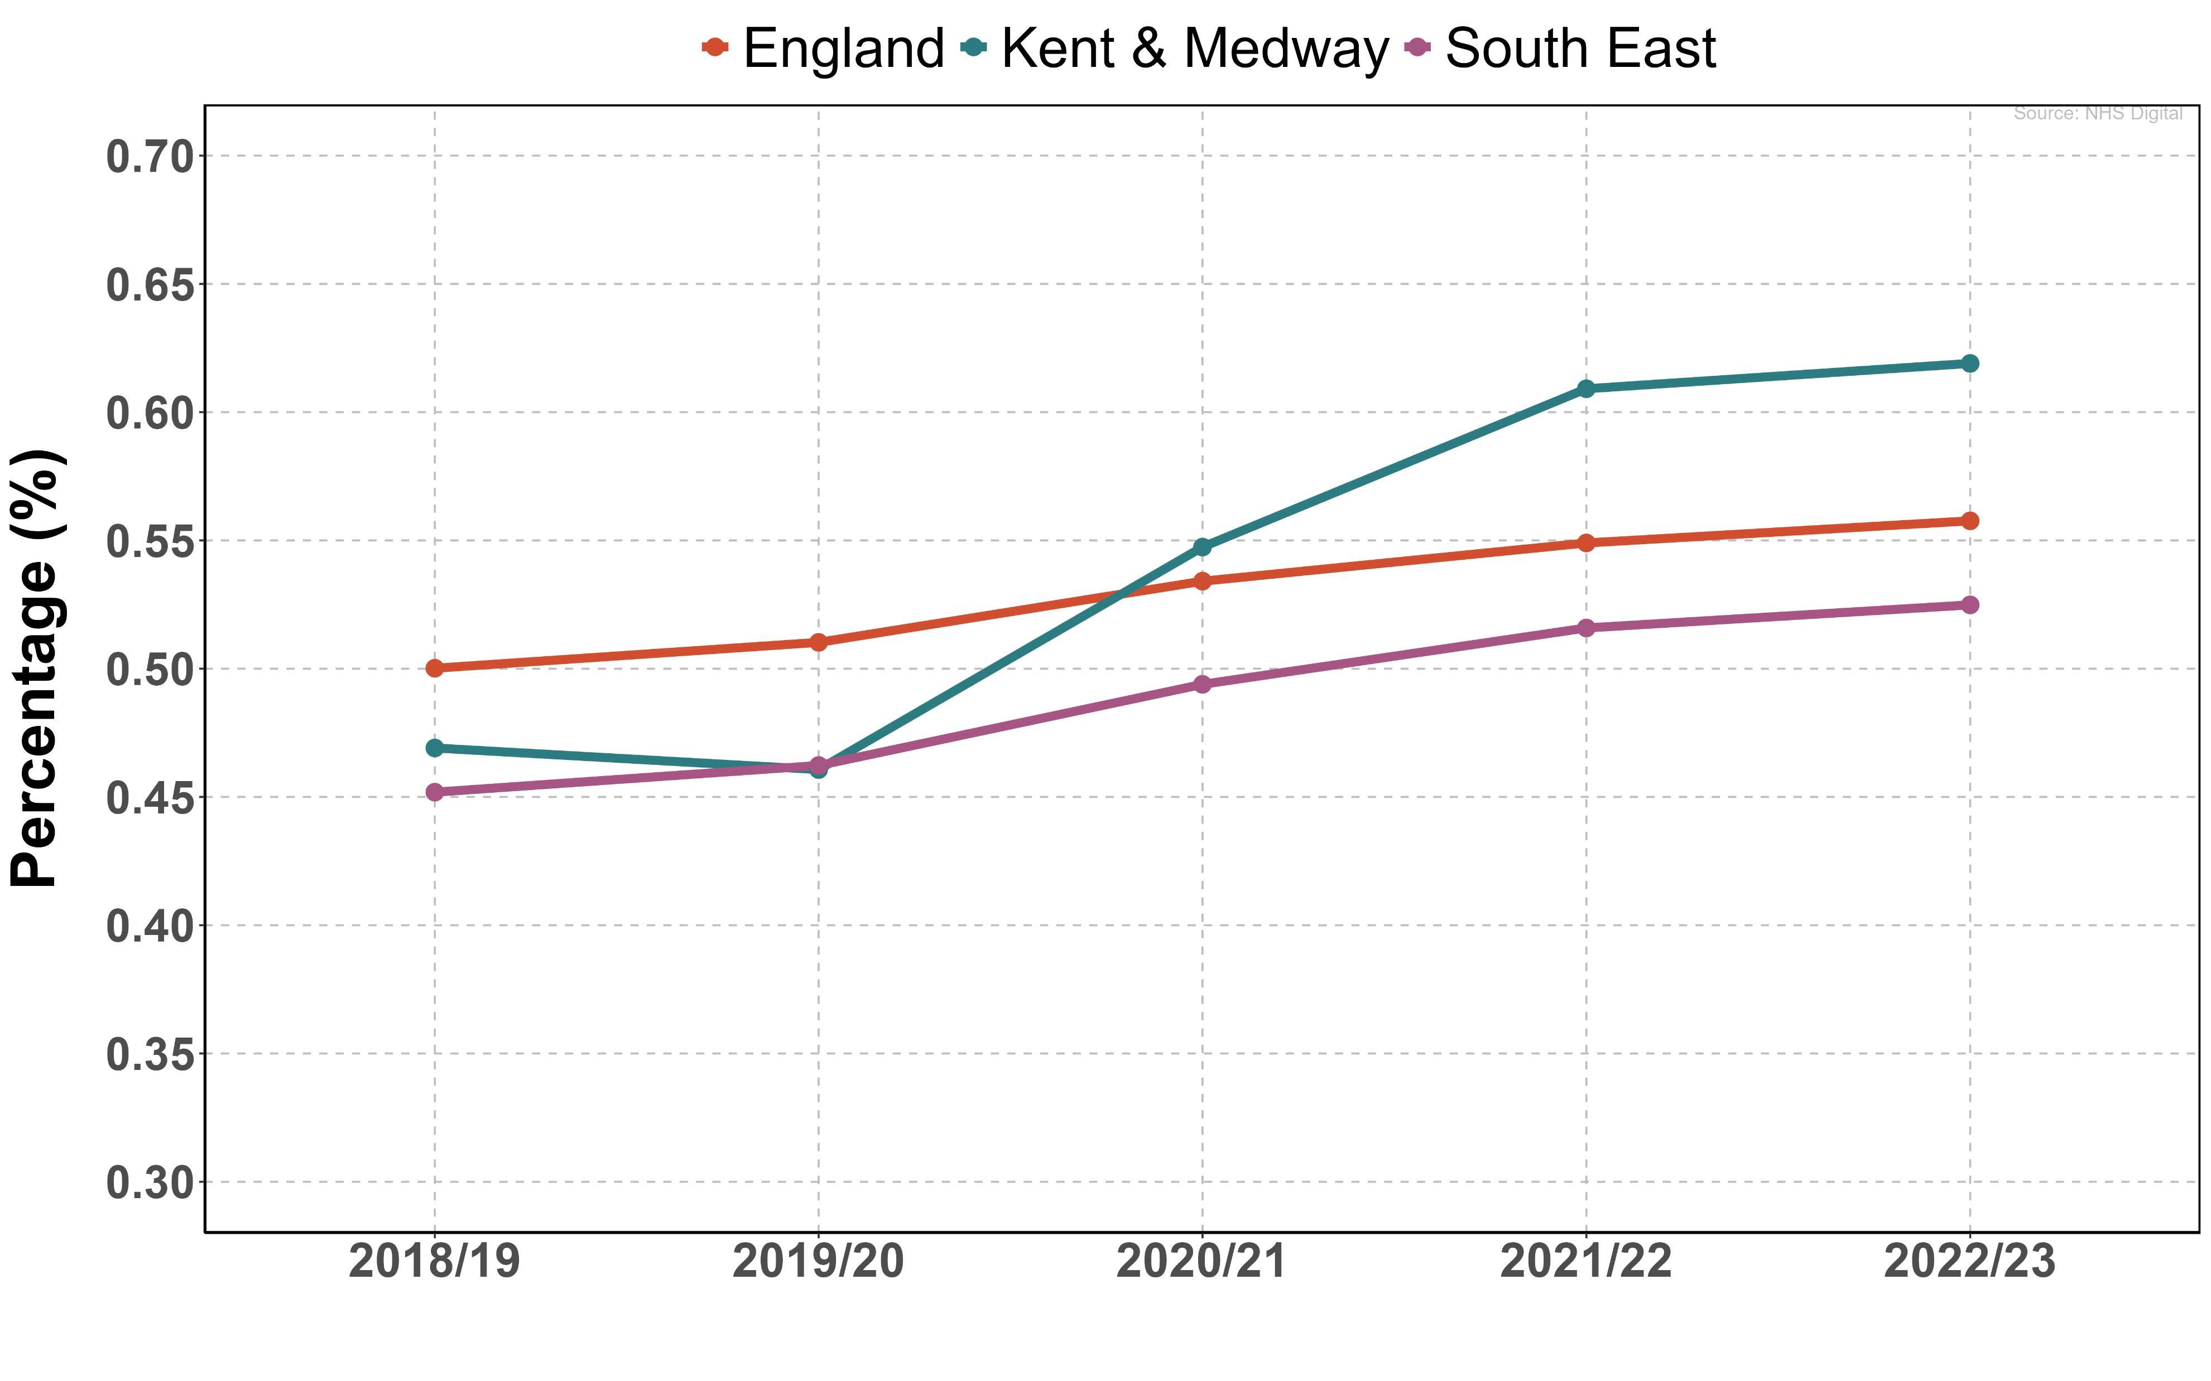
The Prevalence of a Learning Disability
Across Kent and Medway (K&M) in 2022/23, there are 12,308 registered people with a learning disability (OHID Fingertips).
The prevalence of recorded learning disability in 2022/23 for K&M was 0.62% (0.61%-0.63%), higher than the national prevalence of 0.52% (0.52%-0.53%) (OHID Fingertips).
The proportion of learning disability patients (all ages) in K&M with a diagnosis of autism was 24.1% for all ages in 2020/21 (NHS Digital).

Slide 5
Education outcomes
Evidence has often shown that people with learning disabilities have worse educational outcomes than people without learning disabilities (Gov.uk).
Children with learning disabilities are less likely to have attended school, have fewer schooling years and are more likely to not have completed education compared to children without a learning disability (ONS, Gov.uk).
People with a learning disability in Kent and Medway has a higher rate of persistent absences compared to the national average. This has been consistently higher since 2017/2018.
Since Covid-19, persistent absentees has increased by more than 10% for both Kent and Medway and England.

Slide 6
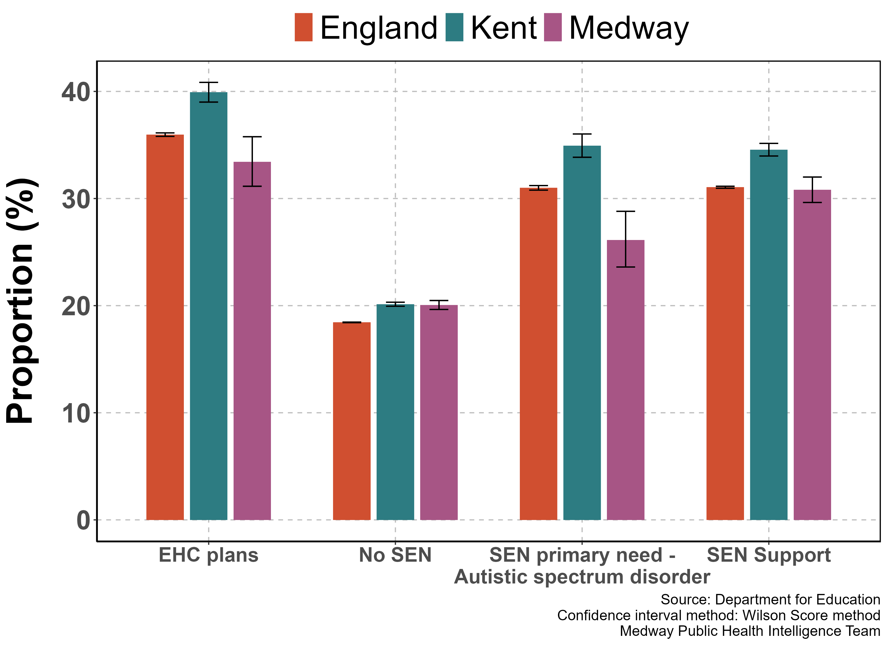
Education outcomes
Rate of persistent absentees by SEN 2022/23
The number of persistently absent pupils (10% sessions missed or more) is significantly lower for pupils with no special educational needs (SEN) compared to pupils with EHC plans or SEN support (Department for Education).
Kent is higher than the England average in all categories for absentees.

Slide 7
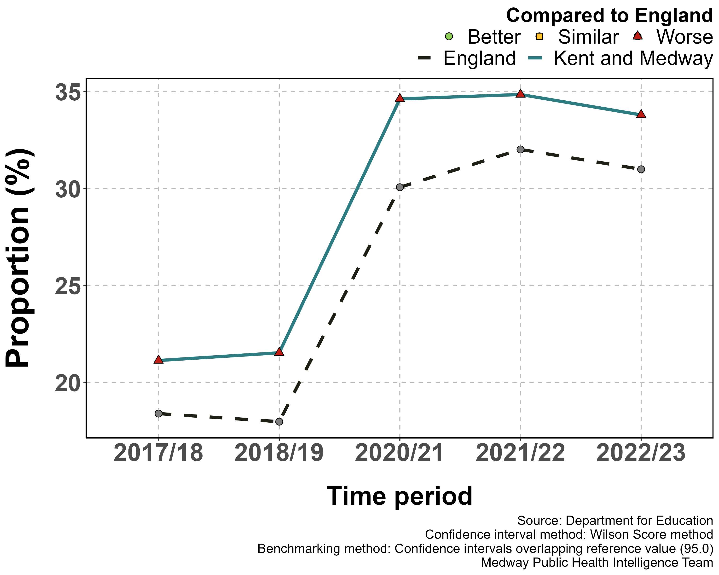
Education outcomes
Rate of persistent absentees with Autistic spectrum disorder in Kent and Medway
The number of persistent absentees with Autism spectrum disorder is significantly higher than that of pupils with no SEN and is significantly worse in Kent and Medway compared to the England average (Department for Education).

Slide 8
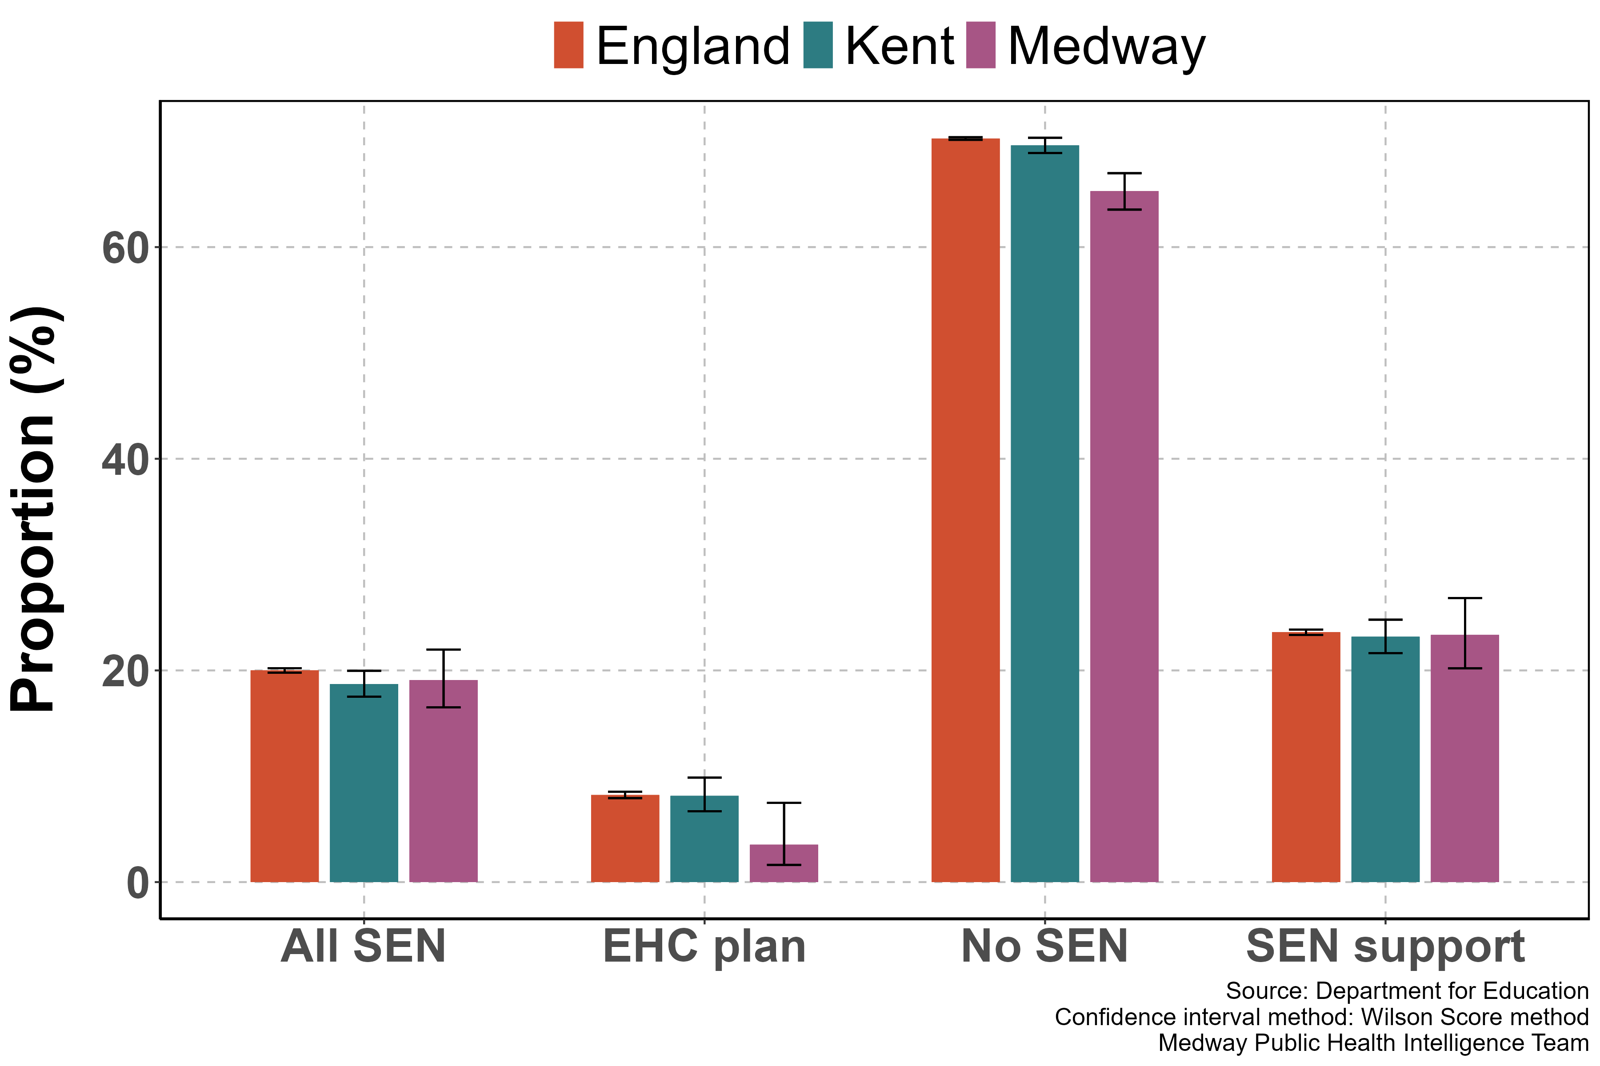
Education outcomes
Percentage of pupils meeting the expected standard in reading, writing and maths at the end of Key Stage 2 by SEN status in state-funded schools, 2022/23
Pupils with no identified SEN have significantly better Key Stage 2 and Key Stage 4 outcomes compared to pupils with SEN (Department for Education).
Unlike some of the other metrics, Kent and England are comparable for educational outcomes.

Slide 9
Employment Rates for People with a Learning Disability
With learning disabilities affecting people's ability to process complex information and learn skills, the employment rate for people with a learning disability is significantly lower than the general population.
The government has committed to reduce the gap between the employment rates of disabled and non-disable people (known as the disability employment gap) (Gov.uk).
In Kent, the employment rate for this group is significantly lower than the national and South East region average. More needs to be done to understand the underlying reasons and how best to address this (OHID Fingertips).
In the past four years, employment rates for people with a learning disability has stayed the same, suggesting more support is needed to get people into the workplace (OHID Fingertips).

Slide 10
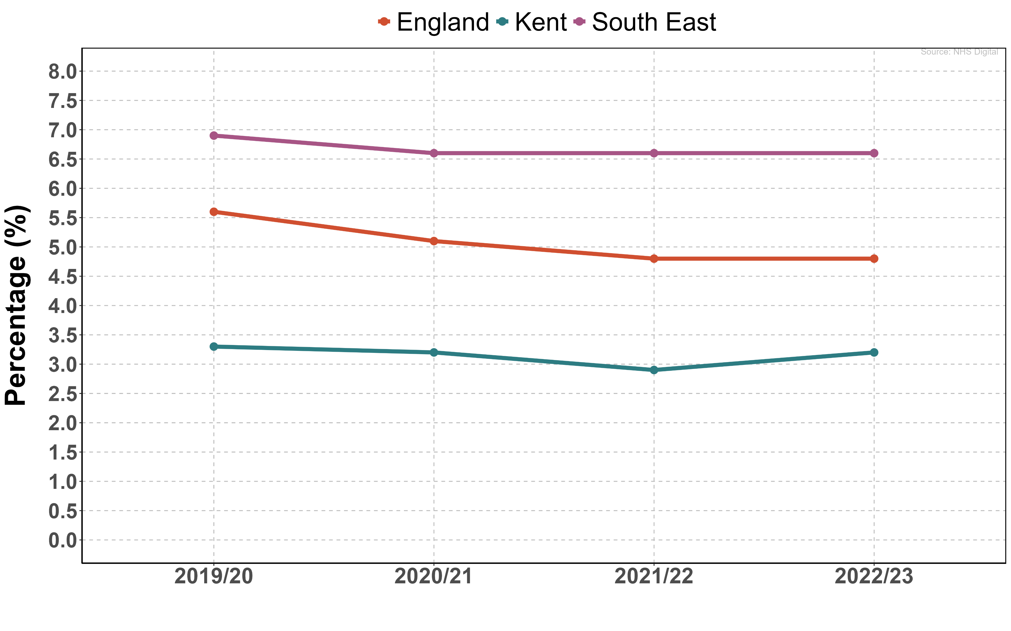
Employment Rates for People with a Learning Disability
The proportion of people with a learning disability in the county of Kent in paid employment was 3.2% (2.5%-4.3%) in 2022/23.
The South East region was considerably higher with 6.6% (6.3%-7.0%) in paid employment in 2022/23. (OHID Fingertips)

Slide 11
Learning Disability Health Checks
People with a learning disability often have poorer physical and mental health when compared to the general population.
Consequently, all people registered with a learning disability aged 14 and over are eligible for an annual health check in primary care, however not everyone currently uses this service (NHS UK).
Kent and Medway have a lower proportion of eligible patients having an annual health check compared to the average in England (Learning Disability Health Check Scheme (LDHC) Mar 2024, NHS England).

Slide 12
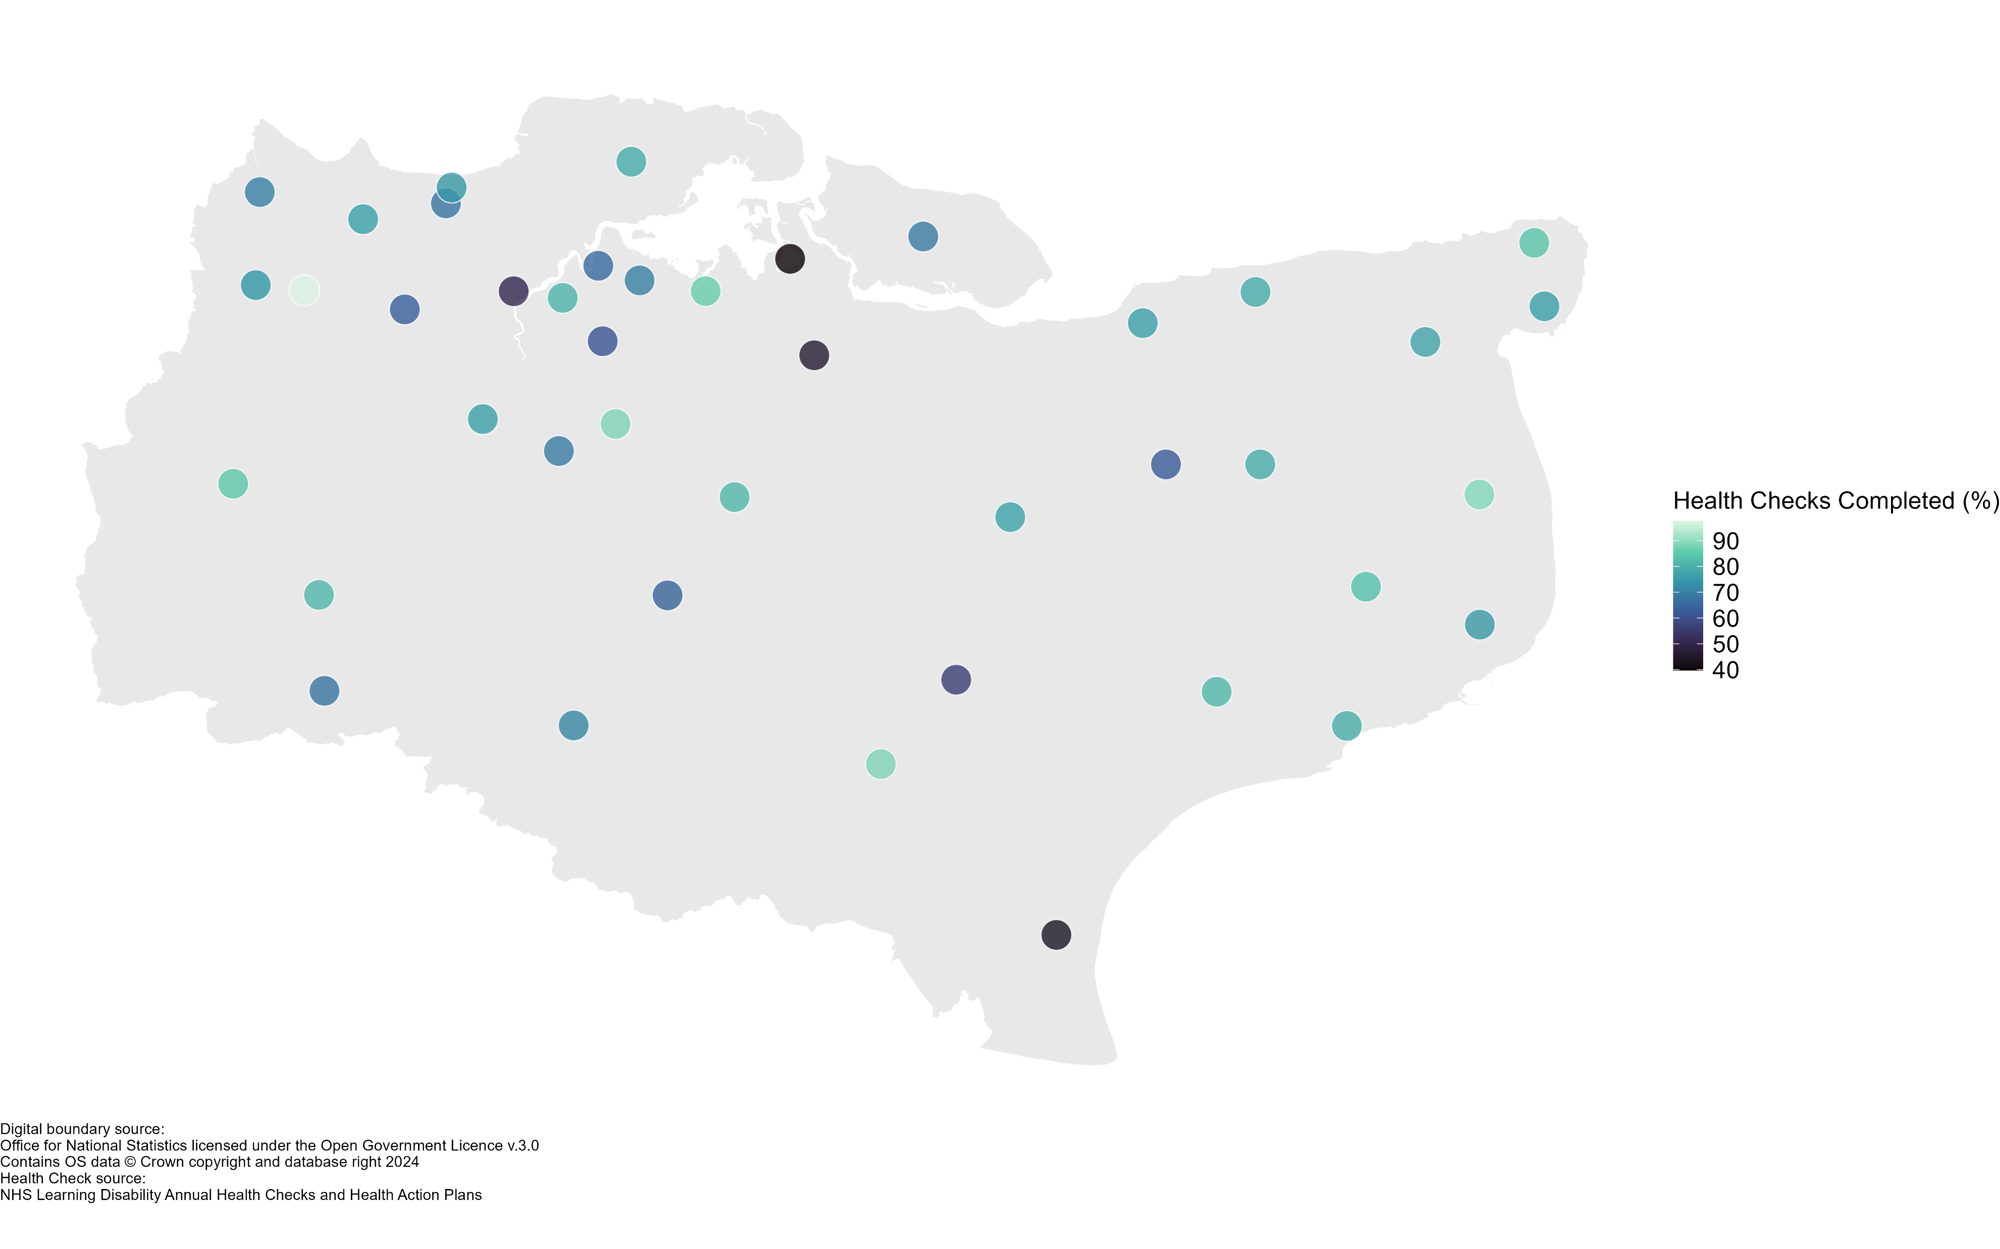
Learning Disability Health Checks
The proportion of eligible patients (age 14+) in K&M with a learning disability who had a GP health check in 2023 was 73.8%, which equates to 7360 completed health checks.
The proportion of eligible patients (age 14+) in England with a learning disability who had a GP health check in 2023 was 79.1%, Which equates to 226,701 completed health checks. (Learning Disability Health Check Scheme (LDHC) Mar 2024, NHS England).
PCNs with less than 60% of health checks completed for eligible patients:
Marsh PCN
Strood PCN
Sittingbourne PCN
Ashford Medical Partnership
MPA PCN

Slide 13
Flu Vaccination Rates in People with a Learning Disability
Studies have shown that respiratory problems are a major cause of death among people with learning disabilities (Gov.uk).
Since 2014, people with learning disabilities have been eligible to receive a free flu vaccine but there has not been an appreciable rise in people using this service.
For all ethnicities other than White, flu vaccine rates are below 50%.

Slide 14
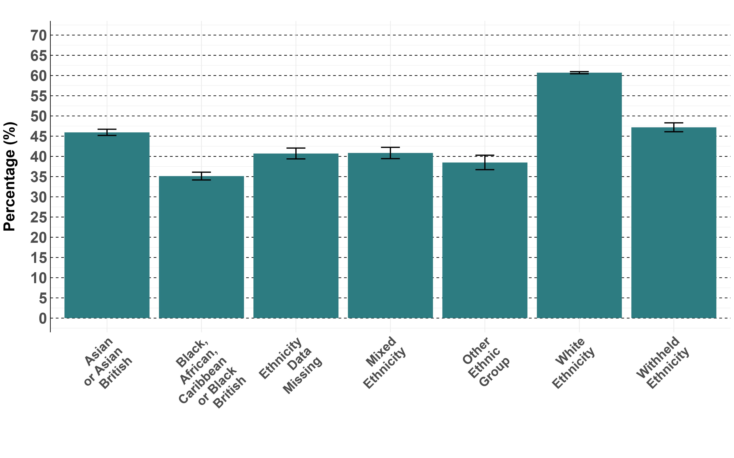
Flu Vaccination uptake by Ethnicity in People with a Learning Disability
Patients of a white ethnicity had the highest uptake of flu vaccinations compared to all other ethnicities. Those patients of a Black, African, Caribbean or Black British ethnicity had the lowest proportion of uptake with only 35% of eligible patients having a flu vaccine. (NHS Digital).

Slide 15
People with a Learning Disability and Other Long-Term Conditions
As mentioned before, people with learning disabilities are more likely to suffer from other physical and mental conditions, including a range of long-term health conditions.
The majority of patients with learning disabilities in Kent and Medway have another long-term condition (Outcomes Based Healthcare and Kent and Medway ICB).
12,308 people in Kent and Medway are registered as having a learning disability (Outcomes Based Healthcare and Kent and Medway ICB).
Deaths from an avoidable cause make up nearly half of all deaths in people with learning disabilities, nearly double that of the general population (Public Health England).

Slide 16
People with a Learning Disability and Other Long-Term Conditions
61.1% of all patients in Kent and Medway who have a learning disability also have another long-term condition.
18% (2376) of people with a learning disability are also registered as having depression in Kent and Medway.
Notably, the prevalence of obesity in people with a learning disability is 23.8% (3139), significantly higher than the general population at 15.4%.
Condition | People count | Percentage (%)
Learning Disability | 5,130 | 38.95%
Learning Disability, Physical Disability | 1,000 | 7.59%
Depression, Learning Disability | 758 | 5.76%
Epilepsy, Learning Disability, Physical Disability | 549 | 4.17%
Epilepsy, Learning Disability | 534 | 4.05%
Asthma, Learning Disability | 452 | 3.43%
Learning Disability, Serious Mental Illness | 185 | 1.40%
Depression, Learning Disability, Physical Disability | 159 | 1.21%
Hypertension, Learning Disability | 158 | 1.20%
Diabetes, Learning Disability | 130 | 0.99%

Slide 17
References
Learning disabilities - NHS (www.nhs.uk)
Learning Disability Profiles - OHID (phe.org.uk)
Health and care of people with learning disabilities - NHS England Digital
Learning disabilities - Annual health checks - NHS (www.nhs.uk)
Health and Care of People with Learning Disabilities, Experimental Statistics 2021 to 2022 - GOV.UK (www.gov.uk)
Improving educational outcomes for learners with specific learning difficulties - GOV.UK (www.gov.uk)

