Slide 1
Tuberculosis in Kent & Medway Health Needs Assessment 2024
Dr Steph Newton - Public Health Registrar
Kent County Council & Kent Public Health Observatory
UKHSA South East Health Protection Team
UKHSA Field Services

Slide 2
Outline
Local, national and international context
TB epidemiology in Kent and Medway
Cohort review data
TB services and commissioning
Migrant population and latent TB screening
Summary of recommendations
Notes:
TB HNA took place over the last 12 months, joint project with UKHSA and Kent County Council, done at a system level for Kent and Medway

Slide 3
HNA Overview
1 year duration - Oct 2023 to Dec 2024. Joint project - UKHSA and Local Authorities (KCC & Medway).
Completed at an ICB level for Kent and Medway. Aim is for a HNA to be completed for each ICB in the SE.
Quantitative & qualitative methods - most of the epidemiological data from NTBS 2014 to 2023.
Key stakeholders - HPT, Field Services, KCC, Medway Council, K&M ICB, Acute and Community Trusts, NHS UASC team and Napier Barracks.
Recommendations in line with the TB national action plan - to inform and support development of a local strategic action plan for Kent and Medway.
Notes:
Surrey and Hampshire and Isle of Wight
Quant data extracted by the Field Services TB team

Slide 4
National and International Context
Worldwide, TB is the 2nd leading cause of death from a single infectious agent (after COVID-19).
England is a low incidence country (8.5 per 100,000 in 2023).
There was a 11% annual increase in TB rates in 2023 in England, the largest year-on-year increase in current reporting periods.
The WHO’s End TB Strategy sets a target incidence of 1.05 per 100,000 for England by 2035.
NHSE and UKHSA’s TB Action Plan for England is the current strategy for improving the prevention, detection and control of TB in England.
Tuberculosis incidence and epidemiology, England, 2023 - GOV.UK
The End TB Strategy, 2015, WHO
Tuberculosis (TB): action plan for England, 2021 to 2026 - GOV.UK
Notes:
10 per 100,000 is the WHO’s threshold for high incidence.
The COVID-19 pandemic in 2020 had a significant impact on the detection and control of TB, leading to missed or delayed diagnoses and delayed initiation of treatment.
England is not on track to achieve the WHO target.

Slide 5
Local Context
The SE-TBCB works with local partners to implement the national strategy.
This includes four TB networks (Kent and Medway is one) with membership from various stakeholders - local authorities, UKHSA, the ICB and TB services.
Kent and Medway is a low incidence area for TB, but complexity of cases is high.
The HNA aims to identify how to address unmet need in the treatment, control and prevention of TB, and support development of a local strategic action plan for Kent and Medway.
Notes:
SE-TBCB - South East TB Control Board
UKHSA – UK health security agency
ICB – integrated care board
HNA – health needs assessment
The last HNA was in 2016 – significant changes since then.

Slide 6
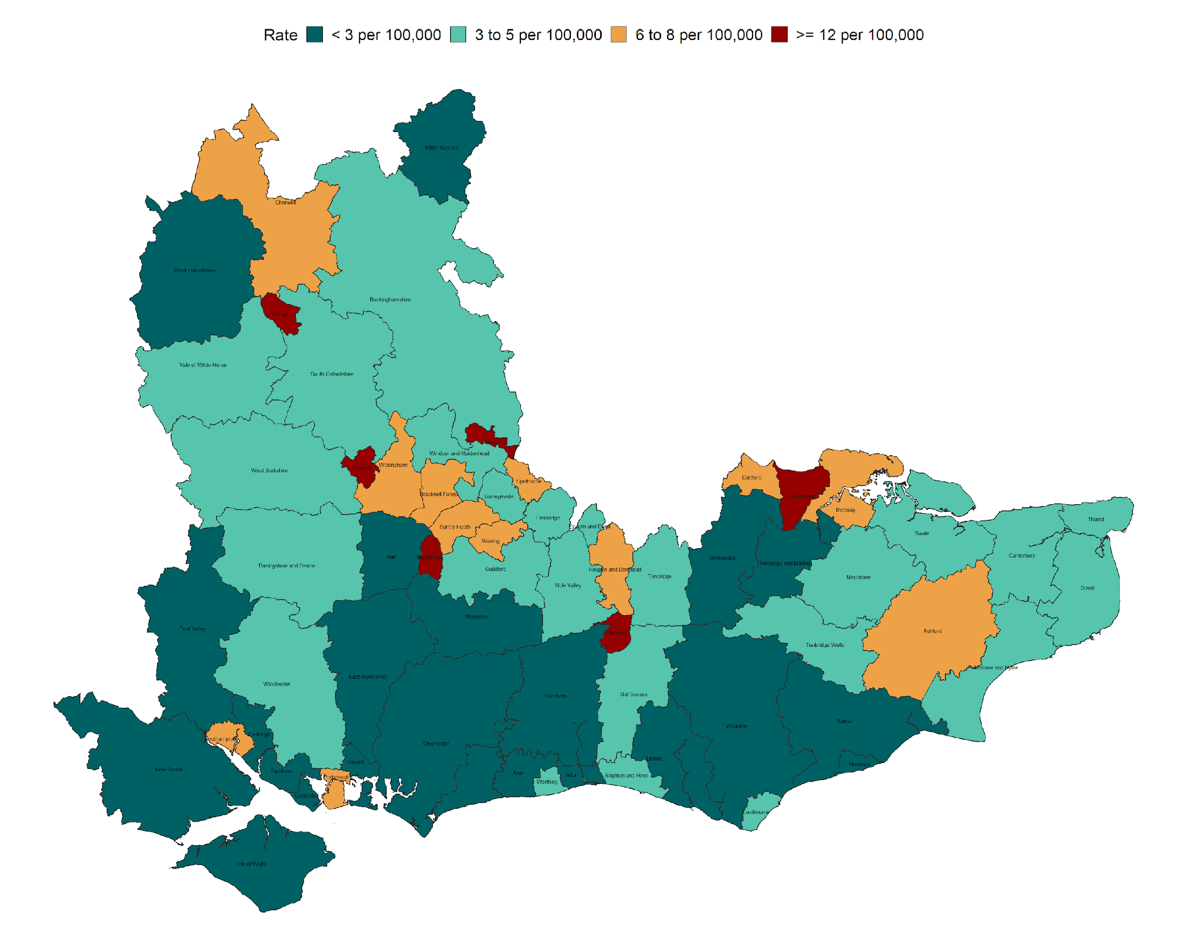
TB Epidemiology in Kent & Medway (1)
105 cases in 2023, a rise since the 79 cases in 2020.
Highest incidence in Gravesham, Dartford, Medway and Ashford.
57% of cases male, median age 37 years.
75% of cases non-UK born, most have been in the UK for >10 years.
Highest proportion of non-UK born cases in the UK for <2 years in 2023.
11% of cases in healthcare or social care workers, 7% in those in education (2014-2023).
Three-year average annual TB incidence rate by Lower Tier Local Authority (LTLA), South East England, 2021 to 2023 - Figure prepared by UKHSA Field Service, South East and London team
Data from National TB Surveillance System (NTBS) – UKHSA Field Services
Notes:
Most of the TB notification data is from 2014 to 2023, extracted from NTBS (national TB surveillance system).
Lowest incidence in Sevenoaks and Tonbridge & Malling.
Similar age/sex breakdown to the South East - over the 10 year period.
Nationally, largest increase in 2023 in those who had entered the UK recently (>2 years)
Recommendation: monitor rates in those entering the UK recently, ?due to active TB in migrants who did not have pre-entry screening.
All healthcare workers should have TB screened for in occupational health checks. Unclear from the data if this represents an issue with health checks. Latent TB may be diagnosed but it is not compulsory to have treatment.
Recommendation: Engage with occupational health departments to understand where issues may arise in pre-employment screening for active and latent TB. Explore the options for ensuring screening takes place, including reviewing existing service specifications.

Slide 7
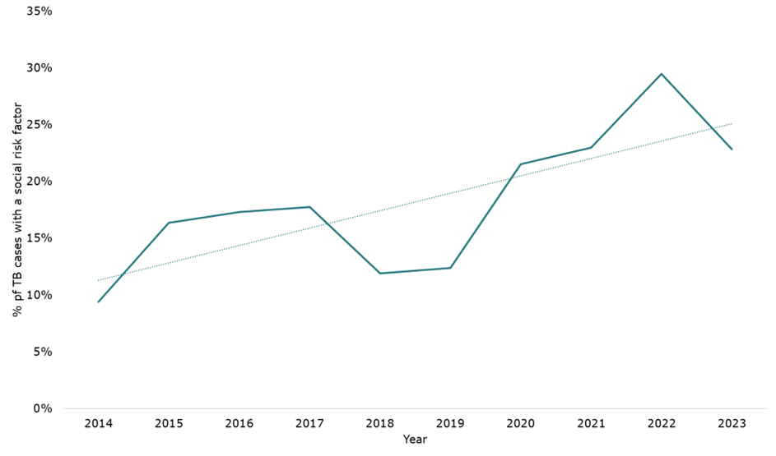
TB Epidemiology in Kent & Medway (2)
Social risk factors (SRF) – alcohol or drug misuse, homelessness, prison incarceration, mental health issues, asylum seekers and immigration detainees.
18% of cases in K&M vs. 11% in SE (2014-2023).
Most commonly drug misuse (36%), homelessness (35%) and prison incarceration (34%).
Of those with a SRF, 39% had more than one risk factor.
Cases with SRFs more likely to be male, of white ethnicity and UK-born.
% of TB cases with a social risk factor in Kent and Medway, 2014 to 2023. Source: NTBS, prepared by KPHO (LS), November 2024
Data from National TB Surveillance System (NTBS) – UKHSA Field Services
Notes:
K&M = Kent & Medway
TB infection is associated with many social determinants of health (conditions in which people are born, live and work, influencing health inequalities). Social risk factors are those that can lead to people experiencing social exclusion, stigma and discrimination, resulting in barriers in access to healthcare and poor health outcomes. (TB incidence and epidemiology, England, 2022 - GOV.UK). These factors are often intersecting.
Only 6 Social risk factors collected in NTBS.
Recommendation: To consider introducing active case finding outreach services in K&M, such as the UCLH Find & Treat service (and other examples can be found in the TB IHG toolkit), to identify more undiagnosed TB cases, particularly in inclusion health groups. This is likely to be of benefit, given the high proportion of socially complex cases identified in K&M.
Recommendation: TB prevention and early diagnosis should be focussed in areas and population groups where social risk factors for TB infection are highest, including drug and alcohol misuse, homelessness, prisoners and deprived areas.

Slide 8
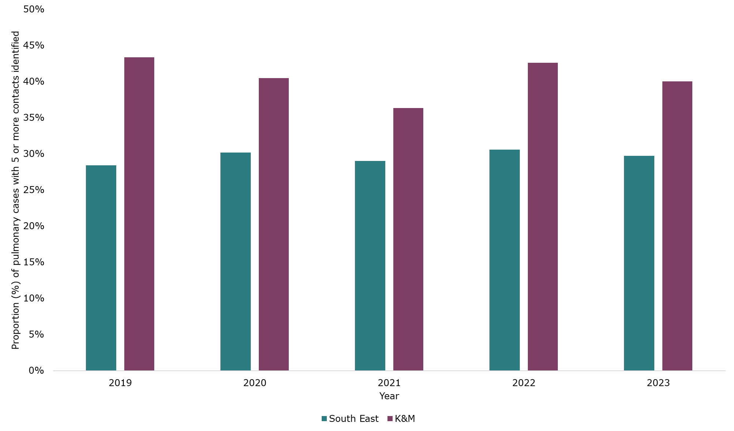
Cohort Review (1)
57% of cases were pulmonary.
(2014-2023)
17% of cases had co-morbidities.
(2014-2023)
Over 80% of pulmonary cases confirmed with a culture result (2023).
84% offered and completed a HIV test (2023).
7 MDR cases (2014 and 2023).
>1 contact identified in 80% of cases, >5 contacts in 40% of cases (2019 to 2023).
Proportion (%) of all pulmonary cases with 5 or more contacts identified in Kent, Medway and the South East, 2019 to 2023. Source: NTBS, GOV.UK, prepared by KPHO (LS), November 2024
Data from National TB Surveillance System (NTBS) – UKHSA Field Services
Notes:
Cohort review – systematic review of all TB cases notified in a 3 to 4-month period, to review outcomes for those patients and identify issues arising in the area.
Data here is also from NTBS, between 2014 and 2023.
If presenting outside of public health - TB can cause pulmonary disease (infectious = public health concern), and extra-pulmonary disease (can affect most areas of the body).
All suspected TB cases should have a sample tested for diagnosis.
MDR – multi-drug resistant = resistant to rifampicin, with or without isoniazid (Methodology and definitions - GOV.UK) – 7 cases is low.
HIV – untreated HIV infection increases the risk of developing active TB disease.
Contacts = assessment and screening of close contacts of people with TB to identify undiagnosed active or latent TB
K&M consistently better than the South East average
Recommendation: To ensure all people with TB are offered a HIV test.

Slide 9
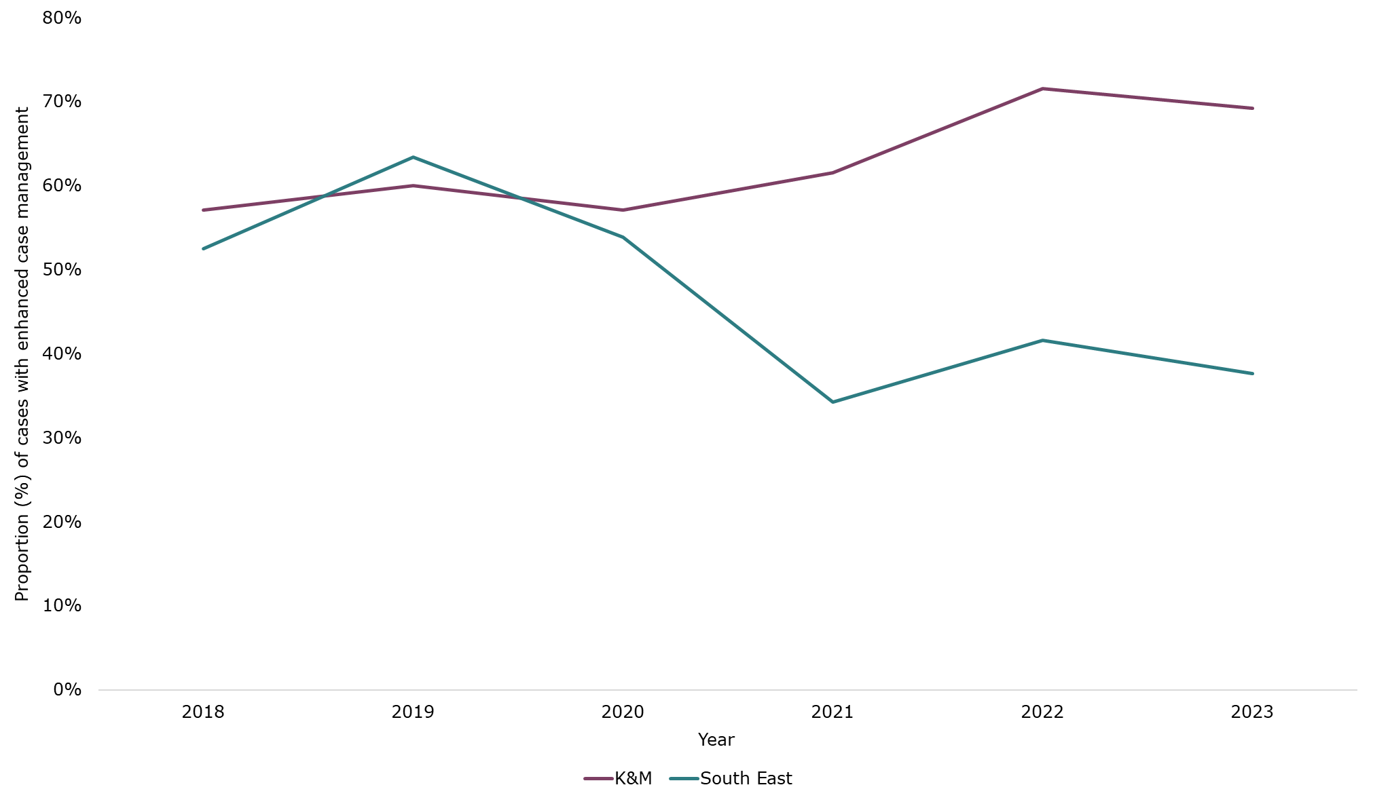
Cohort Review (2)
72% of cases required enhanced case management vs. 42% in SE and 43% in England (2022).
36% offered DOT/VOT vs. 19% in SE (2022).
>90% of drug-sensitive cases completed treatment (2022 & 2023).
Less likely to complete treatment if male, over 65, UK-born, white ethnicity, social risk factors.
Proportion (%) of TB cases requiring ECM in Kent, Medway and the South East, 2018 to 2023. Source: NTBS, GOV.UK, prepared by KPHO (LS), November 2024
Data from National TB Surveillance System (NTBS) – UKHSA Field Services
Notes:
Cohort review – systematic review of all TB cases notified in a 3 to 4-month period, to review outcomes for those patients and identify issues arising in the area.
Enhanced case management = enhanced support from TB nursing teams required due to clinical or social issues that can impact on treatment completion.
DOT = directly observed therapy
VOT = video observed therapy
Recommendation: Ensure all TB services have the resources required, including sufficient TB case managers, and DOT/VOT availability to support the high proportion of cases requiring enhanced case management.

Slide 10
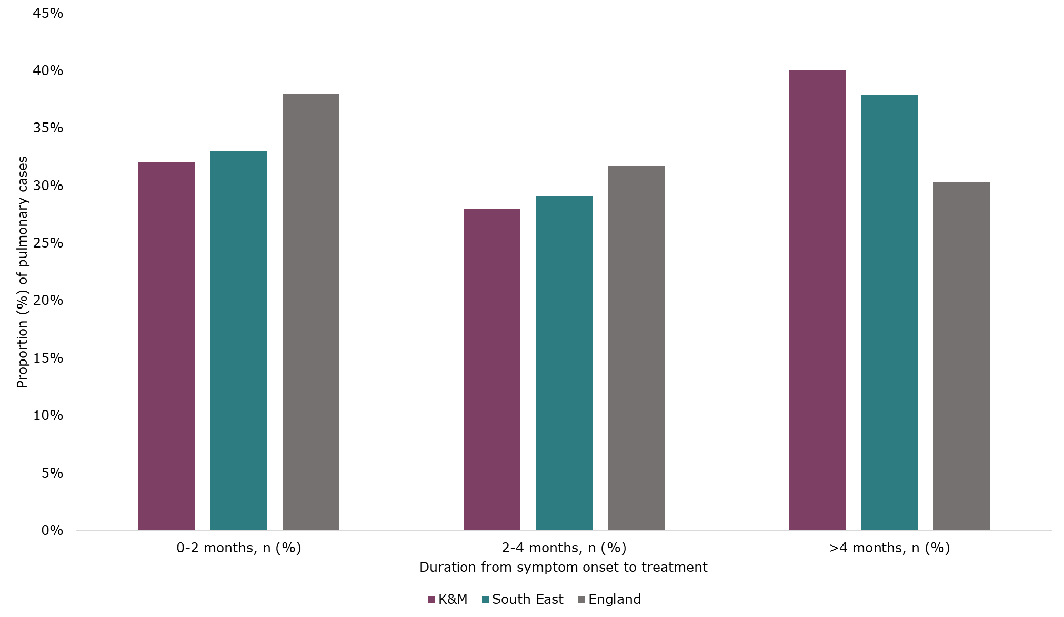
Cohort Review (3)
28% treatment delay of 2-4 months, 45% delay of >4 months (2014-2023).
Treatment delay is the time between symptom onset and treatment
Poor access to primary care
Lack of awareness of TB in public
Lack of awareness of TB in healthcare professionals
Lack of formal referral pathways
Long wait times in some clinics
High DNA rates
Proportion (%) of pulmonary TB cases, by symptom onset to treatment duration, in Kent and Medway, the South East and England, 2022. Source: NTBS, GOV.UK, prepared by KPHO (LS), November 2024
Local diagnostic testing not available for every service
Data from National TB Surveillance System (NTBS) – UKHSA Field Services
Notes:
Cohort review – systematic review of all TB cases notified in a 3 to 4-month period, to review outcomes for those patients and identify issues arising in the area.
Recommendation: Ongoing review of cases with delays in cohort review meetings, to discuss and implement local actions to reduce delays. Annual monitoring of delay data to understand where delays occur and to review if local actions are effective.
Recommendation: Improve public awareness of TB symptoms, to encourage engagement with healthcare professionals and early diagnosis. This could take place as part of World TB Day communications.
Recommendation: To increase education and training about TB symptoms and signs to healthcare professionals to improve early diagnosis. Ideally a regular programme of education activities, including induction training for primary care, A&E and secondary care departments who may be involved in TB recognition and diagnosis. This may require increased resources and staffing for the TB services to deliver this routinely.
Recommendation: To consider introducing a centralised website for K&M TB services to increase awareness and easy access to referral pathways for healthcare professionals and professionals working with high-risk populations. If no centralised system, ensure information on access to TB services is available on all TB services websites.
Recommendation: To explore the ability to do local TB diagnostic testing in Medway and EKHUFT to reduce delays in diagnosis and risk of infection control issues within acute trusts. If this is not possible, to understand how the process of transporting and testing samples in neighbouring trusts, along with communicating results can be improved.
Reasons for delays given by TB services
Long wait times for clinics generally for LTBI

Slide 11
TB Services – Acute and Community Services
4 acute providers and a community provider for TB services across K&M.
Services generally in areas of high incidence but gaps in East Kent – covering a large geography.
KCHFT East Kent has the highest number of cases most years.
Three-year average annual TB incidence rate by LTLA for 2021 to 2023, with location of TB service hospital sites in Kent and Medway. Source: Fingertips and local data, prepared by KPHO (LS), November 2024
Notes:
Recommendation: In East Kent in particular, access to hospitals may be difficult due to the large geographical area covered by its two hospitals. Financial and social support should be in place for cases who may find it difficult to travel to hospital sites in order to reduce DNA rates.
Recommendation: To explore the feasibility and need for community TB clinics in East Kent.

Slide 12
TB Services – Issues Identified
Lack of consistent referral pathways across the multiple providers.
Lack of formal referral pathways for high-risk populations.
Insufficient staffing – increasing referrals, complex patients, incidents requiring mass screening, lack of admin support.
No commissioning for managing LTBI cases in KCHFT (N&E Kent) – acute trusts start treatment but no further follow up.
Lack of data on LTBI cases diagnosed and treatment completion.
Notes:
LTBI = latent TB infection
High risk populations – asylum seekers, and homeless population
UASC or children in the household of someone with active TB are supported by KCHFT, outside of commissioning though.
Recommendation: Review referral pathways for TB services to ensure clear and easy access pathways are in place for referrals from primary care, A&E, histopathology and radiology in particular.
Recommendation: To consider introducing a centralised website for K&M TB services to increase awareness and easy access to referral pathways for healthcare professionals and professionals working with high-risk populations. If no centralised system, ensure information on access to TB services is available on all TB services websites.
Recommendation: To ensure links with local outreach services are in place in MTW and Medway to support management of high-risk cases.
Recommendation: To explore Medway’s access to on-site interpreters to support with management of cases and ensure the service’s access to interpreters is in line with the other services in K&M.
Recommendation: To consider expanding the TB specialist nursing service to include staff that can support with outreach activities and DOT, considering the number of cases requiring enhanced case management in K&M.
Recommendation: To consider how the K&M TB services can work together to provide cross-cover arrangements in times of reduced capacity of the workforce. Alternatively to consider a single commissioned TB service across K&M to ensure consistency and an equitable service across the area.
Recommendation: To review commissioning and service specifications for respiratory services in acute trusts to include dedicated time for TB work for consultants and administrative staff.
Recommendation: To ensure regular data collection for the number of cases with LTBI and treatment completion rates in K&M.
Recommendation: To ensure commissioning is in place for LTBI case management by TB specialist nurses, to improve LTBI treatment completion rates.

Slide 13
TB Services – Positives
Good links with community outreach services in KCHFT (N & E Kent) but less support in Medway and Maidstone.
All TB services provide teaching for other health and social care professionals.
Formal pathways in place with prison services in Medway and Maidstone.
Good working relationships between TB nurses, consultants and microbiology.
Contact tracing and treatment outcomes amongst the best in England.
Positive feedback from service users.
Notes:
Medway and MTW acute trusts less access to outreach services – essential given the high proportion of cases with social risk factors

Slide 14
TB Services - Commissioning
In Medway and Maidstone, TB services provided as part of the respiratory department, no specific commissioning in place.
In KCHFT (N&E Kent), no commissioning for latent TB management.
Increasing number of incidents requiring mass screening, a SOP and formal pathways for funding required.
Increasingly complex TB cases, requiring funding for incentives, enhanced case management and social workers and a formal pathway for funding for those with no recourse to public funds.
System workshops have taken place to review the inequality in provision of services, and work is underway to address this.
Notes:
SOP – standard operating policy
Recommendation: To establish a SOP and formal pathway for funding for TB incidents requiring mass contact screening, to ensure staff and other resources are available when required, as per the national service specification. Alternatively, to use the existing general MOU in place for incidents requiring a public health response.
Recommendation: To ensure commissioning is in place for LTBI case management by TB specialist nurses, to improve LTBI treatment completion rates.
Recommendation: Continue to work on a risk sharing agreement between the LA and ICB for those requiring support who are homeless, with NRPF.
Recommendation: Explore the possibility of funding for a dedicated TB service social worker to support K&M’s high number of complex TB cases to facilitate registration with GP practices, attendance at appointments for testing and completion of treatment. Funding for social workers to support enhanced case management is supported by NICE guidance and the national service specification.
Recommendation: Explore the commissioning arrangements to support treatment completion for socially complex cases, including support for travel costs, accommodation and food and provision of incentives or conditional cash transfers. Funding for incentives to support enhanced case management is supported by NICE guidance and the national service specification.
Recommendation: Explore the commissioning arrangements for TB services within acute trusts to ensure funding streams specifically for TB are in place.

Slide 15
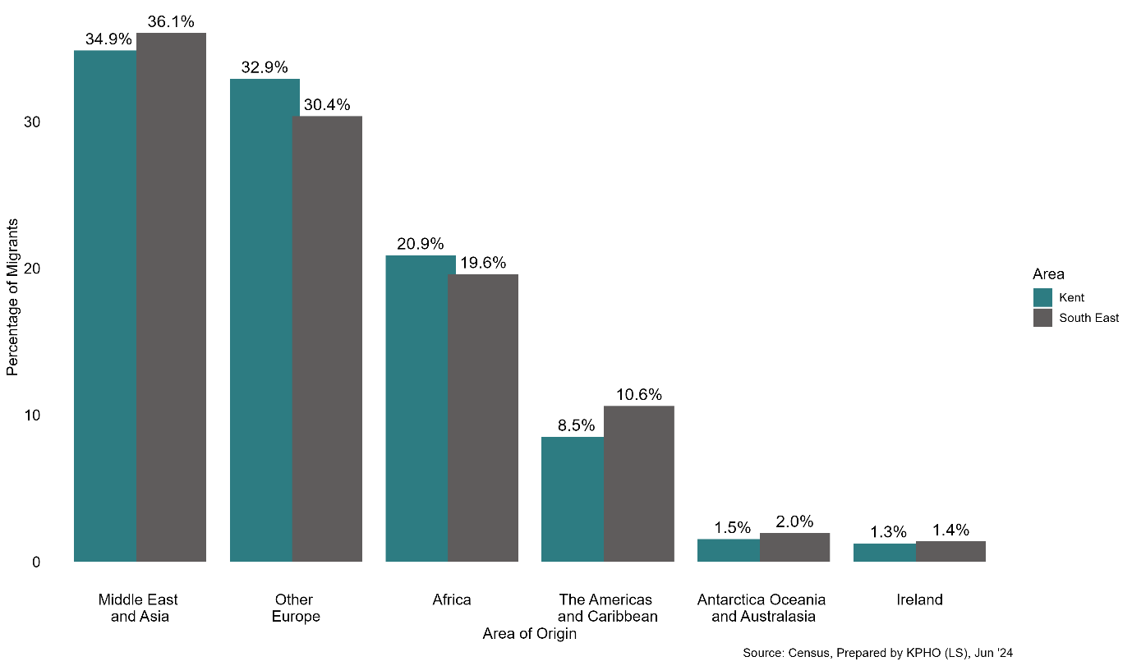
Migrant Population
In 2021/22, 7,100 people migrated into K&M from outside the UK, highest net migration in the past decade.
Those born in a country with a high incidence for TB are at a high risk of developing active TB in the UK with many developing TB >10 years after arrival to the UK.
Vulnerable migrants, including asylum seekers, have additional risks for developing TB – conditions during journey to UK, poor living conditions in UK, barriers to accessing healthcare, malnutrition, stigma.
Proportion (%) of migrants in Kent and Medway, by country of origin, 2021. Prepared by KPHO (LS), November 2024
Tuberculosis (TB): migrant health guide - GOV.UK
Tackling TB in inclusion health groups: a toolkit for a multi-agency approach - GOV.UK
Notes:
Recommendation: Increase awareness in migrants from high-incidence countries of the symptoms of active TB and what to do if they develop them. This is of particular importance given the high net international migration seen in K&M in recent years. This could take place as part of World TB Day communications.
Recommendation: Increase awareness for primary care health professionals of the continued risk of active TB, including extra-pulmonary TB in migrants from high-incidence countries many years after arrival to the UK. This is of particular importance given the high net international migration seen in K&M in recent years. This could take place as part of World TB Day communications or by encouraging completion of the RCGP learning module by TB alert.

Slide 16
Migrant Population – active TB screening
Active TB screening should take place before entry to the UK, but those arriving via unofficial routes will not be screened.
Adult asylum seekers will need to register with a GP and have an initial health assessment. Lack of data around how often this takes place in primary care, and if screening for TB is prioritised.
Unaccompanied asylum-seeking children are screened for both active and latent TB during their IHA which generally takes place (statutory requirement).
At Napier Barracks, a GP outreach clinic is in place where everyone is offered a screening questionnaire for TB.
Issues identified – no clear arrangement for who should screen new entrants, barriers for patients attending appointments, lack of TB awareness in accommodation settings, short-notice relocation out of area affecting continuity of care, lack of social support for cases needing treatment.
Notes:
Issues identified by stakeholder engagement (with healthcare professionals working with adult and child asylum seekers) and via the NHSE South East public health team.
Recommendation: Increase awareness in asylum seekers of the importance of registering with a GP practice, and support them in accommodation settings to do so.
Recommendation: Improve awareness in primary care of the right of asylum seekers, people who are homeless and other IHGs to register with GP services, support staff to develop registration processes that are inclusive and reinforce the importance of screening for TB during health assessments, as set out in the Migrant health guide.
Recommendation: Increase awareness in staff working in asylum accommodation settings of the symptoms of active TB, how to access referral pathways and infection prevention and control measures. This is of particular importance in new reception centres being set up for children in K&M.
Recommendation: Establish a clear pathway in K&M for initial health assessments for adult asylum seekers, including responsibility for screening for active TB, to reduce the likelihood of individuals with active TB being placed in accommodation settings without appropriate isolation.
Recommendation: Explore the option for commissioning an outreach service or specialist general practice service for asylum seekers that can provide initial health assessments, including TB screening. This can also offer an opportunity to carry out health checks for other diseases and provide vaccinations and other prevention interventions. Good practice exemplars and recommendations for implementation can be found in the UKHSA IHG toolkit and Doctors of the World’s toolkit.
Recommendation: Work with asylum accommodation settings and the Home Office to improve communication with TB services in K&M to improve information sharing when cases move out of area before or during TB investigation and treatment. An exemplar of good practice for this recommendation is found in the UKHSA IHG toolkit.

Slide 17
Migrant Population – latent TB screening
NICE – all those from a high-incidence country should be offered screening for LTBI.
6,414 (2,932 – 12,094) migrants identified each year eligible for test
No arrangement in place in K&M.
Modelling by KPHO, based on the NHSE LTBI testing and treatment programme 2021 data in 5 CCGs most similar to K&M.
6.29% (3.27% - 12.53%) tested = 404 (212 – 802) screened
High uncertainty in the modelled numbers.
20.68% (11.3% - 33.1%) positive = 83 (46-134) positive for latent TB
Other factors to consider – GP registrations to identify those eligible, accessible testing locations in the community, culturally sensitive information, training of HCWs on latent TB, laboratory and TB service capacity, funding for case management.
NICE: Tuberculosis
NHS England » National latent tuberculosis infection testing and treatment programme
Notes:
Recommendation: Through engagement with primary care, improve understanding of how often migrants from high incidence countries are screened for active TB and LTBI in primary care and what barriers or issues may exist.
Recommendation: Consider implementation of a LTBI testing programme for migrants from high incidence countries in K&M, to increase detection and treatment of LTBI and reduce the risk of reactivation to active TB.
KPHO – Kent Public Health Observatory team
NHSE LTBI NHS England Latent TB infection
CCG – clinical commissioning group
HCW – healthcare worker
Issues:
Based on one year of data
Applied the proportions of migrants identified in the five CCGs to the K&M population – large range
Very low uptake of screening in these 5 CCGs, target is 25%

Slide 18
Summarised Recommendations (1)
Epidemiology
Monitor the proportion of cases in those who have entered the UK recently
Engage with OH to understand issues with pre-employment screening
Focus on populations with social risk factors
Diagnosis and Treatment
Ensure all TB cases offered a HIV test
Ongoing review of delays in cohort review with implementation of local actions to reduce delays
Explore local diagnostic testing in Medway and East Kent
Access to Services
Ensure support in place for cases to travel to hospitals
Explore need for community TB clinic in East Kent, given the large geography
Review referral pathways to TB services and consider a centralised system
Improve public and healthcare professional awareness of TB symptoms to improve early diagnosis
Notes:
OH – occupational health

Slide 19
Summarised Recommendations (2)
Commissioning
Ensure sufficient resources for enhanced case management, DOT/VOT and outreach activities within TB services
Consider cross-cover arrangements between services or a single commissioned TB service in K&M
Ensure dedicated TB work for consultants and administrative staff in service specifications
Consider introducing active case finding outreach services
Establish a clear pathway for screening for active TB in adult asylum seekers, including the option of a commissioned outreach service
High-Risk Populations
Ensure links with local outreach services in place in Medway and Maidstone
Increase awareness of TB in migrants, healthcare professionals and staff working in asylum accommodation settings
Encourage and provide support for asylum seekers to register with a GP, support GP practices to have inclusive registration processes
Work with the home office to improve information sharing when cases move out of area during TB investigation and treatment
Latent TB Screening
Ensure commissioning is in place for LTBI case management by TB specialist nurses
Ensure regular data collection for LTBI treatment
Improve understanding of how often migrants from high incidence countries are screened in primary care
Consider implementation of a LTBI testing programme for migrants from high incidence countries

Slide 20
Thank you, any questions?
steph.newton@ukhsa.gov.uk

